Slide 1

Data Structures
Lecture 14: Priority Queues, Huffman Trees

Slide 2






Priority Queues
Priority queues push/pop elements in priority order.
Like heaps, priority queues allow duplicate elements.
Heaps are very efficient for implementing priority queues.
Function | Behavior
 | Inserts an item into the queue
 | Removes the largest/smallest entry.
 | Returns the largest/smallest entry without removing it.
 | Returns the number of items in the priority queue.
 | Returns true if the queue is empty.

Slide 3
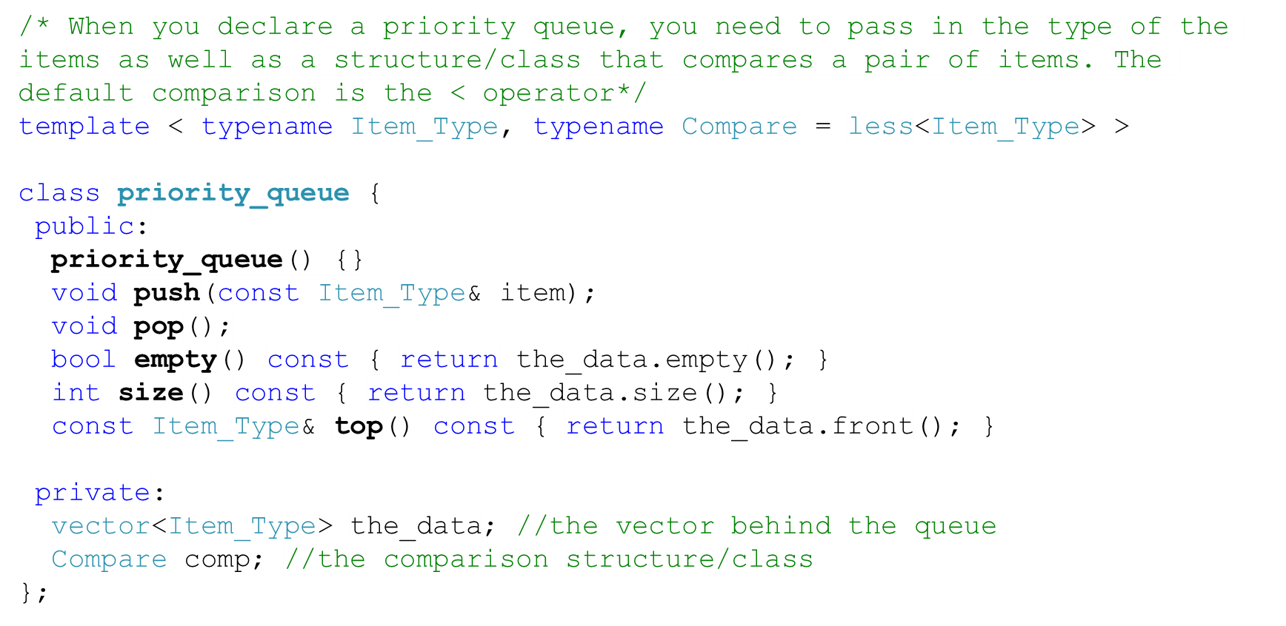
priority_queue Class

Slide 4
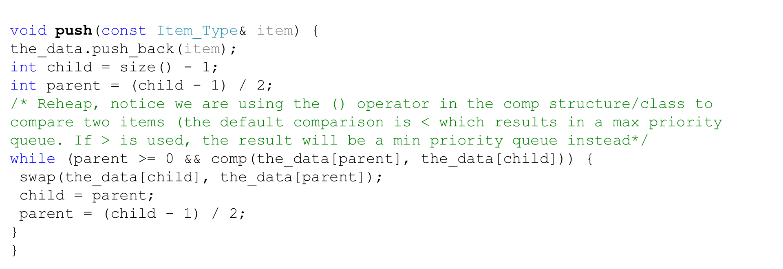
Priority Queues – push() Function

Slide 5
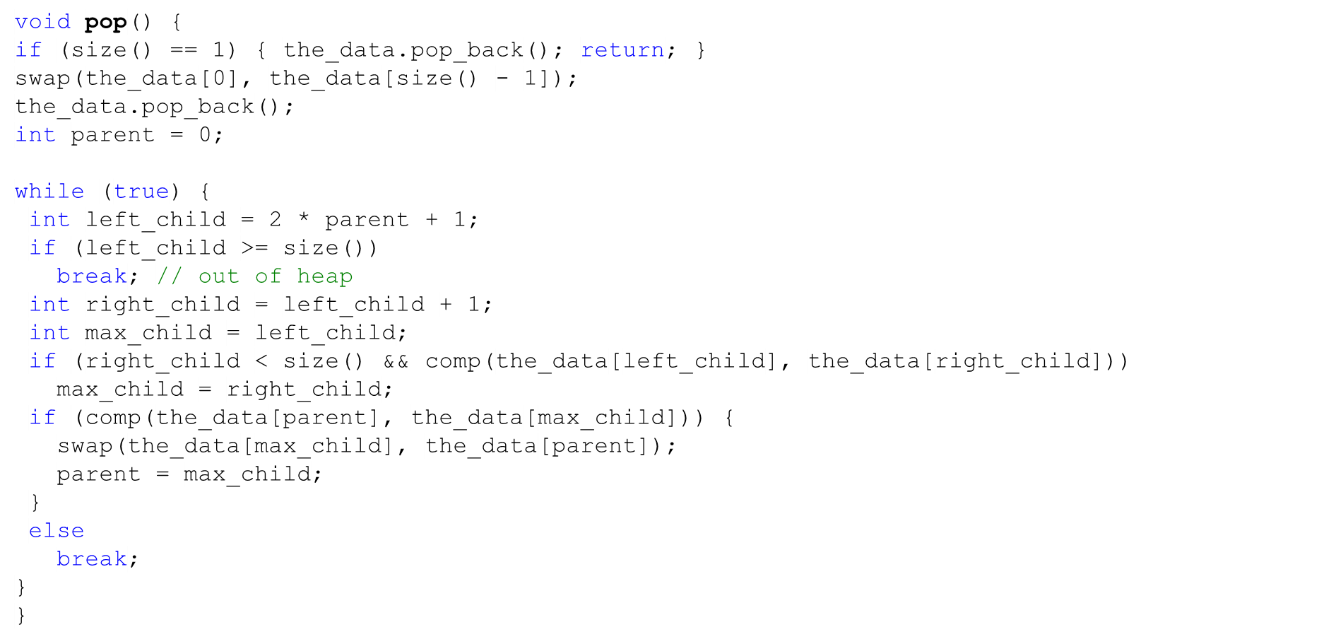
Priority Queues – pop() Function

Slide 6

Task
Write a function that changes the priority of an item with a given index. You may assume the function is a member function of the priority queue class
For instance, the function should change the priority of item at index 1 to “12”. As a result the queue will have to be rearranged.
10
8
9
7
5
6
0 | 1 | 2 | 3 | 4
10 | 8 | 9 | 5 | 6

Slide 7
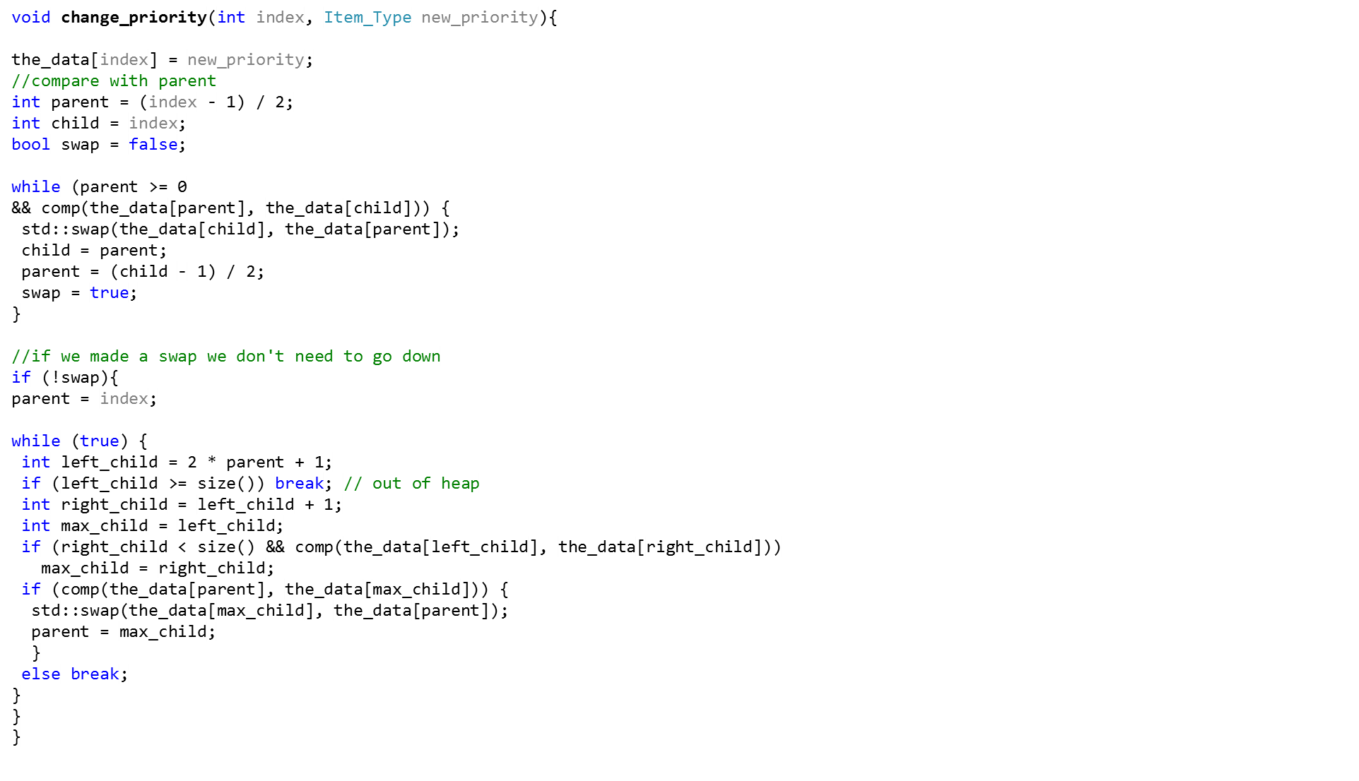
Task - Solution
10
12
7
12
10
5
8
9
7
5
6

Slide 8
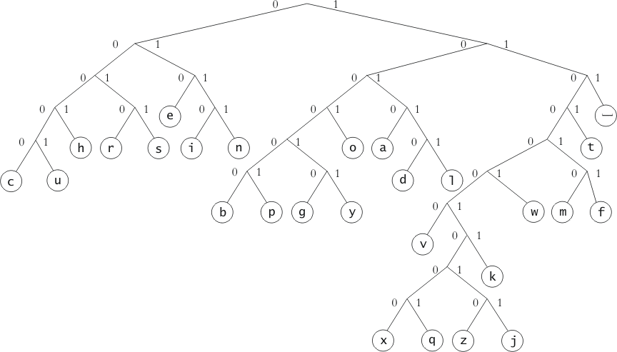
Huffman Trees
Huffman trees are used to represent characters
Use a different number of bits to represent different characters (unlike ASCII.)
Use a fewer bits for common letters (e.g. a, e) or more bits for less common ones (e.g. q, x)

Slide 9
Huffman Trees - Example
1
1
Leaf nodes are letters.
Internal nodes are dummy.
1
0
1
0
0
1
0
0
_
1
1
o
0
g
g o _
1
0
0
0
1
0
1 0 0 1
1 1 1
Can we represent the letters in internal nodes?

Slide 10
Implementing Huffman Trees
Symbol | Frequency
__ | 186
e | 103
c | 22
u | 23
92
45
47
22
23
The letters that have higher weights (frequencies) are higher in the tree (hence, they have a shorter code)
The letters with lower weights are lower in the tree (hence, they have a longer code).
Dummy nodes have weights that are the sum of the left and right children’s weights.

Slide 11
Building a Custom Huffman Tree with Priority Queues
234
234
64 | 67 | 103
a |  | e
103 | 131
e
13 | 22 | 32 | 64 | 103
b | c | d | a | e
32
d
35 | 64 | 103
 | a | e
103
e
131
0
1
64
a
67
Symbol | Code
a | 10
b | 1110
c | 1111
d | 110
e | 0
e
0
1
a
0
1
32
d
35
d
0
1
b
c
13
b
22
c
Notes:
Min priority queue

Slide 12

Building a long Huffman tree
j | 1
v | 8
q | 1
w | 18
b | 13
x | 1
u | 23
h | 47
m | 20
y | 16
g | 15
c | 22
4
z | 1
o | 63
d | 32
2
2
…..
1
j
1
q
1
x
1
z

Slide 13

Huffman Tree Functions
Function | Behavior
 | Builds the Huffman tree using the given alphabet and weights.
 | Decodes a message using the generated Huffman tree.
 | Outputs the resulting code.

Slide 14
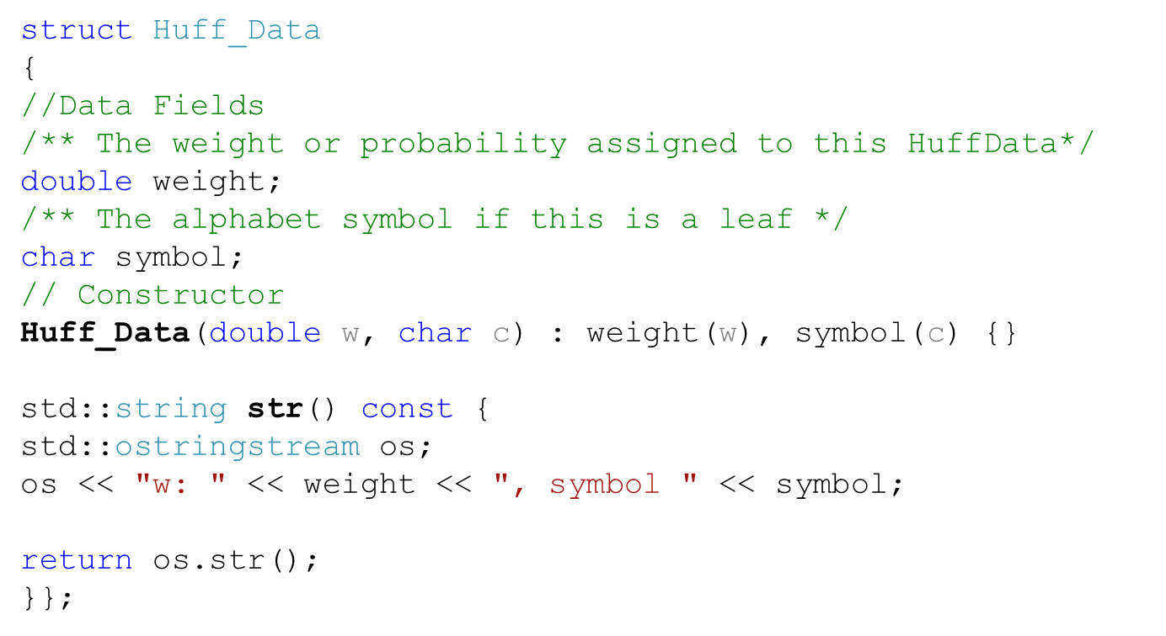
Huff_Data

Slide 15
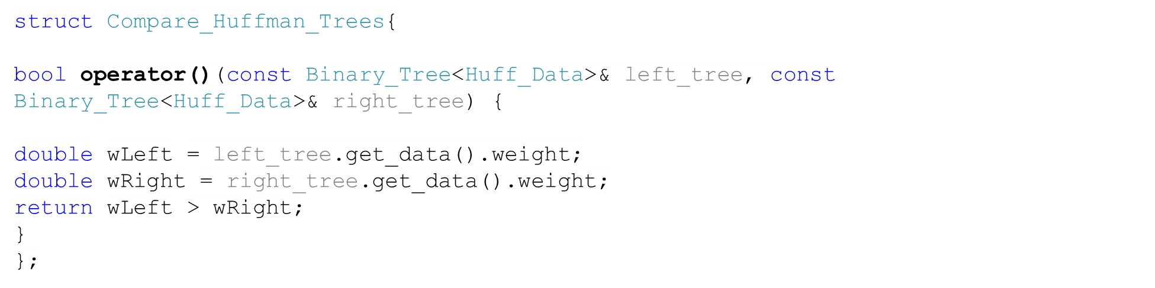
Compare_Huffman_Trees
Notes:
You can define your own as well

Slide 16
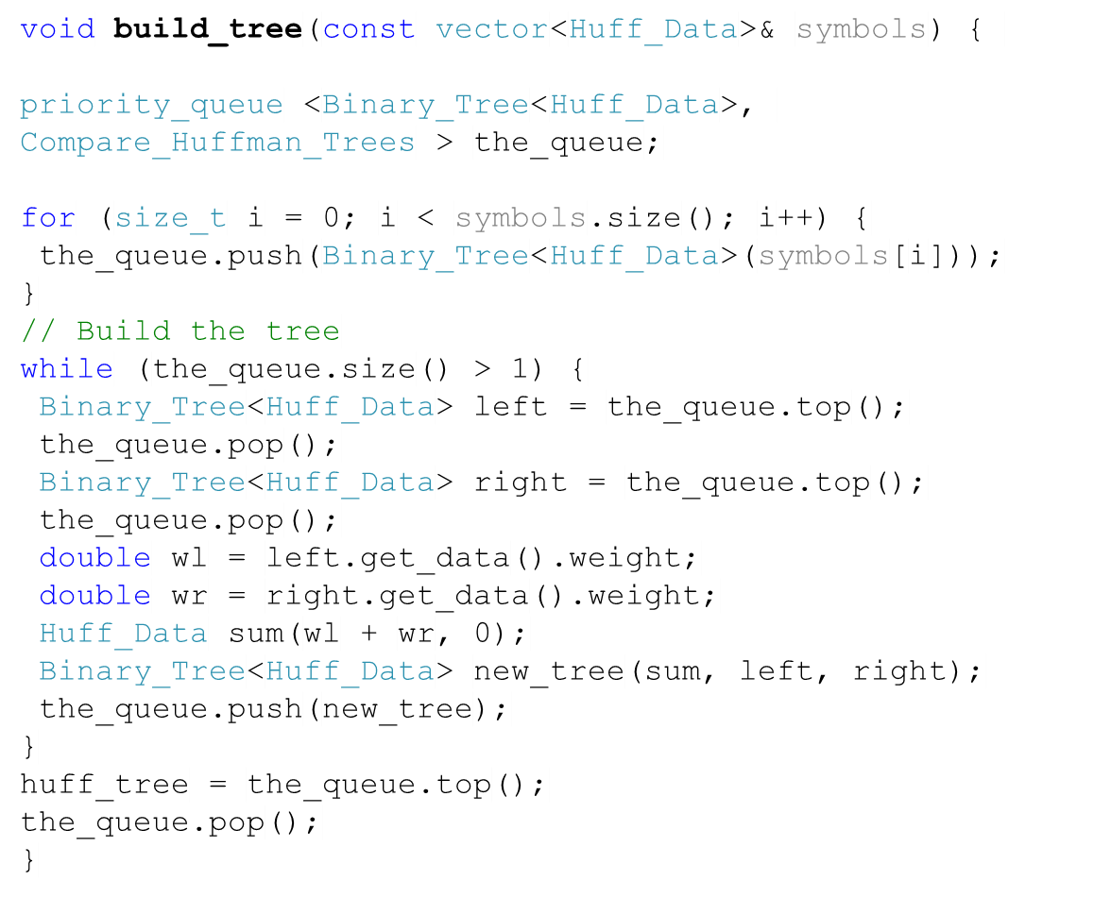
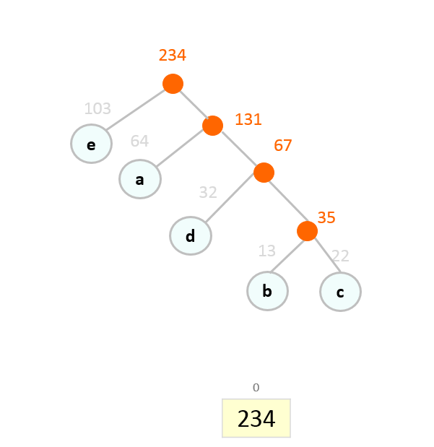

build_tree
64
64
64
32
13
b
32
32
d
22
a
d
a
103
c
a
103
d
103
32
103
103
22
103
e
e
67
67
64
35
e
103
64
32
c
d
a
e
a
e
d
e
13
22
e
64
32
35
64
64
35
103
35
32
b
32
c
35
d
a
d
13
a
a
13
d
e
13
22
22
22
22
13
22
13
13
b
c
b
c
b
c
c
b
c
b
b
0
a
1
e
2
67
0
d
1
e
0
a
1
e
0
d
1
35
2
e
3
a
0
b
1
c
2
d
3
a
4
e
0
c
1
d
0
d
1
a
2
e
2
e
0
d
1
a
3
a
2
e
13 | 22 | 32 | 64 | 103
b | c | d | a | e

Slide 17
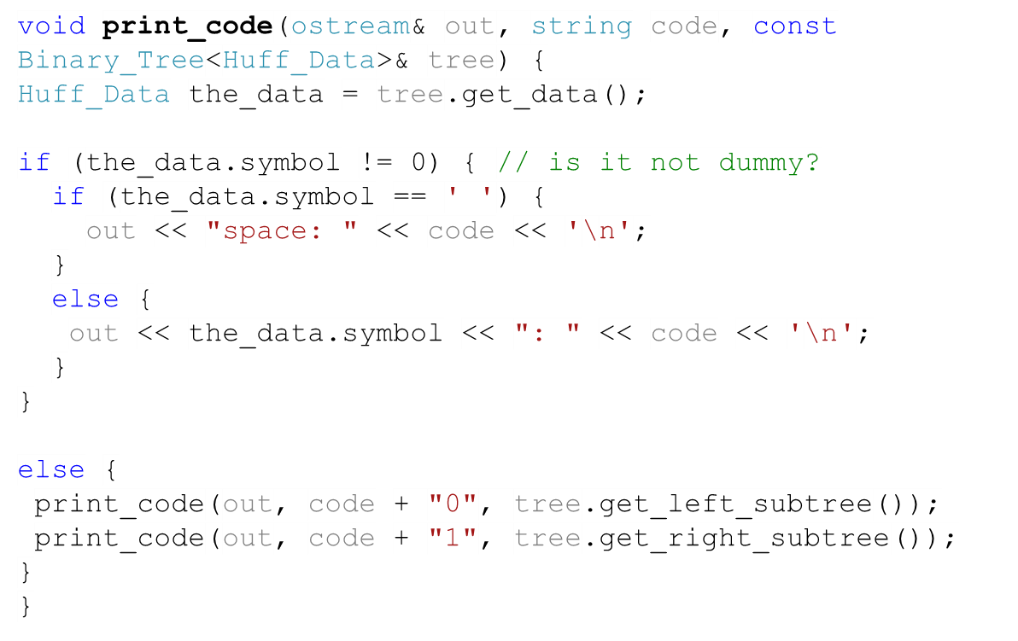
print_code
0
1
10
11
110
111
e | 0
a | 10
d | 110
b | 1110
c | 1111
1110
1111

Slide 18
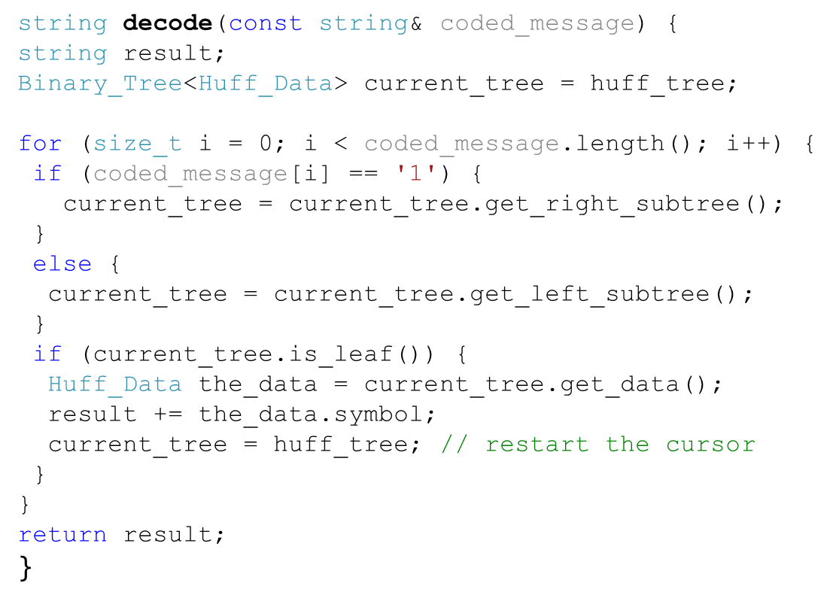
decode
010
e | 0
a | 10
d | 110
b | 1110
c | 1111

